Slide 1
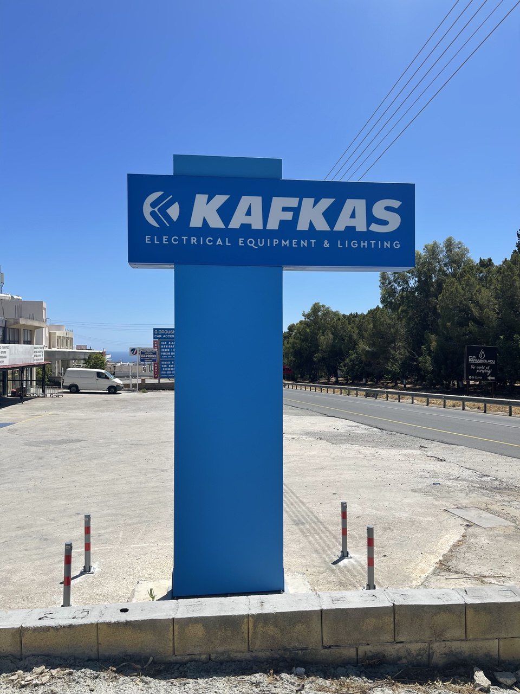
Queues Crash Course
Apache Kafka

Slide 2
What is Apache Kafka?
Distributed streaming platform
For creation, storage, and processing of real-time data streams
Developed by LinkedIn and donated to Apache Software Foundation
Core infrastructure technology for data streams in real time

Slide 3
The purpouse of Kafka
Publish/Subscribe: Kafka acts as a message broker, allowing producers to publish data and consumers to subscribe to the data streams.
Storage: Kafka provides durable storage for streams of records. It can store data with configurable retention policies, ensuring data availability for a specified period.
Data Processing: Kafka Streams and Kafka Connect frameworks allow for real-time stream processing and integration with various data sources and sinks.

Slide 4
Kafka usecases
Real-Time Analytics
Process and analyze data in real-time, gaining insights that drive business decisions.

Slide 5
Kafka usecases
Real-Time Analytics
Event Sourcing
Kafka’s ability to handle high volumes of event data makes it ideal for event sourcing architectures, where state changes are captured as a series of immutable events.

Slide 6
Kafka usecases
Real-Time Analytics
Event Sourcing
Log Aggregation
Kafka aggregates log files from multiple servers and systems, centralizing the log data for further processing and analysis.

Slide 7
Kafka usecases
Real-Time Analytics
Event Sourcing
Log Aggregation
Metrics Collection
Kafka collects and stores metrics data, enabling monitoring and alerting systems to function effectively.

Slide 8
Kafka usecases
Real-Time Analytics
Event Sourcing
Log Aggregation
Metrics Collection
Data Integration
Kafka integrates data across various systems, acting as a bridge between different data platforms and ensuring seamless data flow.

Slide 9
Kafka usecases
Real-Time Analytics
Event Sourcing
Log Aggregation
Metrics Collection
Data Integration
It’s design and capabilities make it an essential tool for modern data infrastructure, supporting a wide range of applications that require robust, scalable, and real-time data processing capabilities.

Slide 10
The history behind Kafka

Slide 11
Linkedin. 2008
User activity logs, application metrics, and operational monitoring
Existing solutions were not scalable
Notes:
2008. There were no microservices. No Kubernetes. Clouds only emerging. SSD’s are rare. NVME does not exist. Distributed log systems are absent. There were even no Tarantool or Redis. There were nothing for accepting hundreds of thousands of messages per second. Durably.

Slide 12
Initial Challenges
Scalability: LinkedIn needed a system that could scale horizontally to handle the vast and ever-growing amount of data.
Durability: Ensuring data integrity and reliability was critical, as data loss or corruption could have significant business implications.
Latency: Real-time data processing was essential for timely analytics and operational insights.
Notes:
Alternatives: scribe, syslog* for logs. activemq/rabbitmq for messages. Statsd, graphite for metrics.

Slide 13
Origin story
Designed from the ground up to be a distributed, partitioned, and replicated log service.
By 2010 demonstrating its effectiveness in Linkedin
In 2011 Linkedin donated it to Apache Software Foundation
Community Collaboration
Wider Adoption
Standardization

Slide 14
Key contributors and milestones
2011: Kafka is open-sourced under the Apache Software Foundation.
2012: v0.7 is released, major improvements in performance and stability.
2013: v0.8 introduces replication, enhancing durability and fault tolerance.
2014: Confluent is established to provide commercial support.
2015: v0.9 adds security features, SSL encryption and authentication.
2016: v0.10 introduces Kafka Streams: native stream processing capabilities.
2017: v1.0 is released, marking its maturity and widespread adoption.

Slide 15
Key contributors and milestones
2011: Kafka is open-sourced under the Apache Software Foundation.
2012: v0.7 is released, major improvements in performance and stability.
2013: v0.8 introduces replication, enhancing durability and fault tolerance.
2014: Confluent is established to provide commercial support.
2015: v0.9 adds security features, SSL encryption and authentication.
2016: v0.10 introduces Kafka Streams: native stream processing capabilities.
2017: v1.0 is released, marking its maturity and widespread adoption.
2020: Kafka introduces the KRaft mode, get rid of dep on ZooKeeper.
2022: v3.0, stable support for KRaft.
2024: v4.0 preview. Major milestone with KRaft fully replacing ZooKeeper.

Slide 16
Key contributors and milestones
2020: Kafka introduces the KRaft mode, get rid of dep on ZooKeeper.
2022: v3.0, stable support for KRaft.
2024: v4.0 preview. Major milestone with KRaft fully replacing ZooKeeper.
2025: v4.0
Kafka Raft (KRaft) instead of ZK
Tiered Storage
Kafka Queues

Slide 17
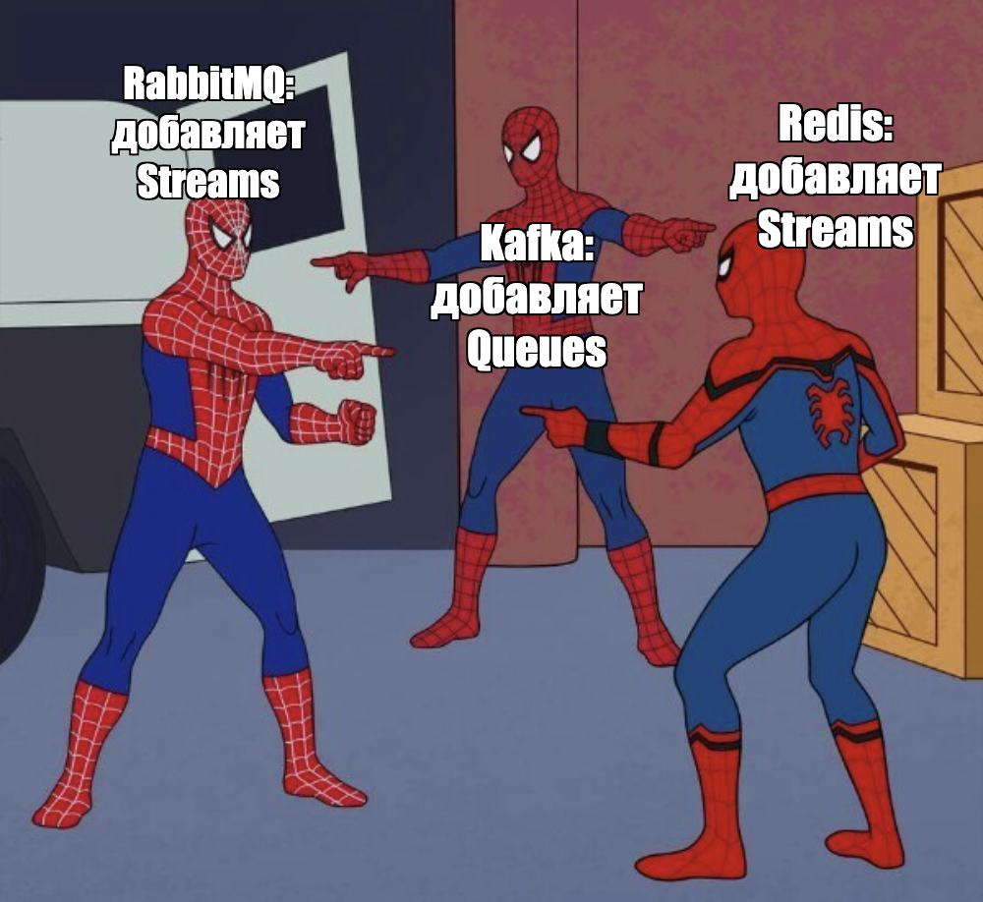

Slide 18
Architecture of Apache Kafka

Slide 19
Kafka components and how they interact
Brokers
Brokers are the servers that form the Kafka cluster.
Each broker is identified by a unique ID and is responsible for storing and managing the data for its assigned partitions.
Each partition has one broker acting as the leader and one or more brokers acting as followers.

Slide 20
Brokers
Data Storage: Brokers store data in the form of logs on disk. Each log is a sequence of records that are appended to a partition.
Replication: Brokers replicate data to ensure fault tolerance. If a leader broker fails, one of the followers is promoted to the leader.
Load Balancing: partitions distributed across multiple brokers. The load is balanced, preventing any broker becoming a bottleneck.
Fault Tolerance: Brokers monitor each other’s health through heartbeats. In case of failure, remaining brokers take over.

Slide 21
Brokers: leader and follower
Leader Broker: For each partition, one broker is designated as the leader. The leader is responsible for all read and write operations for its partition.
Follower Brokers: Brokers that replicate the partition are called followers. Followers constantly replicate the data from the leader. They do not serve client requests directly but are ready to take over.
In-Sync Replicas (ISR): Brokers that are fully in sync with the leader. Data is written to all ISRs to guarantee durability and fault tolerance.
Leader Election: When a leader broker fails, a new leader is elected from the ISR. This election is managed either by ZooKeeper or by the KRaft (Kafka Raft).

Slide 22
Kafka components and how they interact
Brokers
Topics and Partitions
Topic is a media, to which records are published
Topics are always multi-subscriber
Each topic is split into partitions for parallelism and scalability
Partitions can be assigned based on keys

Slide 23
Topics
Topic is a logical channel to which records are published and from which consumers can read.
Multi-Subscriber Model: Topics support multiple producers and consumers.
Immutable Logs: Records written to a topic are immutable.
Strict Order: Records are stored in the order they were produced.

Slide 24
Topics
Topic is a logical channel to which records are published and from which consumers can read.
Producer
Consumer
Topic

Slide 25
Topics
Records
Producer
Consumer
m
m
m
m
m
m
m
m
m
m
m
m

Slide 26
Topic partitioning
Each topic can have one or more partitions
Each partition is an ordered, immutable sequence of records.
Scalability: Partitions enable Kafka to scale horizontally.
Parallelism: Partitions allow multiple consumers to read from a topic concurrently.
Each consumer in a consumer group can read from a different partition, enabling parallel data processing.

Slide 27
Topic partitioning
Producer
Consumer
1
2
3
4
5
6
7
8
9
A
B
C

Slide 28
Topic partitioning
1
5
7
9
C
Producer
Consumer
2
4
8
3
6
A
B

Slide 29
Topic partitioning
1
5
7
9
C
Producer
Consumer
2
4
8
3
6
A
B

Slide 30
Topic partitioning
Consumer
1
5
7
9
C
Producer
Consumer
2
4
8
Consumer
3
6
A
B

Slide 31
Topic Partitioning Strategy
DefaultPartitioner (UniformStickyPartitioner) Producers can specify partition Producers can specify a key for each record. Kafka uses this key to determine the partition. Records with the same key are sent to the same partition. Stickiness: producer sticks to partition.
Round-Robin: If no key is provided, records distributed in a round-robin manner.
Custom Partitioners: Kafka allows for custom partitioning logic to be implemented.

Slide 32
Important Partition Configuration
Number of Partitions: The number of partitions for a topic is specified on creation. This number can be increased later but not decreased. The number of partitions affects Kafka's performance. More partitions can improve throughput but increase the load.
Replication Factor: Each partition can be replicated across multiple brokers. The replication factor is defined at the topic level.
Retention Policies: Kafka allows to delete old records by time or by size

Slide 33
Topic partitioning
Consumer
1
5
7
9
C
Producer
Consumer
2
4
8
Consumer
3
6
A
B

Slide 34
Topic partitioning and replication
1
5
7
9
C
Consumer
Producer
Consumer
2
4
8
Consumer
3
6
A
B

Slide 35
Topic partitioning and replication
1
5
7
9
C
Consumer
Producer
Consumer
1
5
7
9
C
2
4
8
Consumer
1
5
7
9
C
3
6
A
B

Slide 36
Topic partitioning and replication
1
5
7
9
C
Consumer
2
4
8
3
6
A
B
Producer
Consumer
1
5
7
9
C
2
4
8
3
6
A
B
Consumer
1
5
7
9
C
2
4
8
3
6
A
B

Slide 37
Consumer
Producer
Consumer
Producer
Consumer

Slide 38
Kafka Log Retention
log.retention.hours=<hours> to keep
log.retention.bytes=<bytes> to keep
Deleted
Retained
1
2
3
4
5
6
7
8
9
A
B
C
Local disk

Slide 39
Tiered Storage in Apache Kafka 4.0
Extended Retention: Maintain historical data indefinitely without overwhelming local disks.
Active Data: Recent data remains on local disks for quick access.
Archived Data: Older segments are transferred to a remote tier transparently.

Slide 40
Kafka Log Retention
remote.log.enabled=true
Deleted
Retained
1
2
3
4
5
6
7
8
9
A
B
C
S3 | HDFS | …
Local disk

Slide 41
Kafka components and how they interact
Brokers
Topics and Partitions
Records (or messages)
A record consists of a key, a value, and metadata.
Records are organized in a log
Each record have unique offset within partition.
Records are stored durably across the cluster.

Slide 42
Kafka record properties
Key: An optional identifier. Can be used for partitioning and affinity.
Value: The main payload of the record. Can be any sequence of bytes up to 1MB.
Timestamp: The time of record creation or log appending. Kafka supports two types of timestamps: create time and log append time.
Offset: A unique identifier of record within a partition. Used by consumer to track their position in the log.
Headers: Optional metadata associated with the record. Can be used for additional context or processing instructions.

Slide 43
Kafka components and how they interact
Brokers
Topics and Partitions
Records
Producers
Client applications that publish records to Kafka topics
Can choose the level of acknowledgment (acks: 0/1/all)

Slide 44
Kafka Producers
Client applications that publish (write) records to Kafka topics.
Synchronous Send: The producer sends a record and waits for a response.
Asynchronous Send: The producer sends a record and does not wait for a response.

Slide 45
Producer acknowledgement strategies (acks).
acks=0: The producer does not wait for any acknowledgment from the broker. The lowest latency but no guarantee of record receival.
acks=1: The producer waits for the acknowledge from the leader broker. This setting provides a balance between latency and durability.
acks=all: The producer waits for acks from all in-sync replicas (ISR). Highest level of durability and fault tolerance. The record is guaranteed to be replicated to multiple brokers.

Slide 46
Kafka components and how they interact
Brokers
Topics and Partitions
Records
Producers
Consumers
Client applications that subscribe to Kafka topics and process the records.
Organized in groups to work on records from a set of partitions
Each partition in one topic is consumed by only one consumer in the group*
Track their position in each partition using offsets
* Except for Kafka Queues enabled topic in 4.0+

Slide 47
Consumers
Client applications that read (consume) records from Kafka topics.
Polling Model: Consumers use a polling model to fetch records from brokers. They periodically request data and process the received records.
Offset Management: Consumers track their position in each partition using offsets. Kafka provides automatic and manual offset management.
Consumer Groups: Consumers are organised in groups, that spread the consumption. Each group consume topic independently.

Slide 48
Offset Management
Commit Strategy: Consumers commit offsets to Kafka to indicate their progress. These offsets can be stored in Kafka’s internal topics or external systems.
Automatic Commit: Offsets are committed automatically at regular intervals.
Manual Commit: Consumers manually commit offsets after processing.
Offset Storage: Kafka stores offsets in an internal topic called __consumer_offsets.

Slide 49
Consumer groups
Each consumer in the group is responsible for consuming records from one or more partitions.
Partition Assignment: Kafka ensures that each partition in a topic is consumed by only one consumer in the group at a time. This prevents duplicate processing and enables parallel consumption.
Rebalancing: When a consumer joins or leaves the group, Kafka triggers a rebalance to reassign partitions to consumers.
Heartbeat Mechanism: Consumers send heartbeats to the Kafka broker to indicate its liveness.

Slide 50
Kafka Queues (Work Queue Semantics)
Introduced in Kafka 4.0 to simplify queue-style messaging
Single Consumer per Record: Each message is processed by only one consumer in the group
Queue Topics: Enable with: queue.topic.enable=true Automatic scaling of consumers without rebalancing Partitioning hidden from the client
Virtual Partitions: Internally used by Kafka for scaling and distribution

Slide 51
Consumer rebalancing
Rebalances can happen in the following conditions:
a consumer joins or leaves the group
partitions are added to a topic
Rebalance strategies and approaches
Consumer Eager Rebalancing (Stop the World)
Consumer Cooperative Rebalance (Incremental Rebalance)
Consumer Static Group Membership

Slide 52
Broker
Topic A
Partition 0
Topic A
Partition 1
Topic B
Partition 0
Topic B
Partition 1
Topic B
Partition 2

Slide 53
Broker 1
Topic A
Partition 0
Topic A
Partition 1
Topic B
Partition 0
Topic B
Partition 1
Topic B
Partition 2
Broker 2

Slide 54
Broker 1
Topic A
Partition 0
Topic B
Partition 0
Broker 2
Topic A
Partition 1
Topic B
Partition 1
Topic B
Partition 2

Slide 55
Records for
A/0, B/0
Broker 1
Topic A
Partition 0
Topic B
Partition 0
Leader
Leader
Producer
Broker 2
Topic A
Partition 1
Topic B
Partition 1
Topic B
Partition 2
Records for
A/1, B/1, B/2
Leader
Leader
Leader

Slide 56
Records for
A/0, B/0
Broker 1
Topic A
Partition 0
Topic A
Partition 1
Topic B
Partition 0
Topic B
Partition 1
Topic B
Partition 2
Leader
Leader
Producer
Replicate
Replicate
Replicate
Replicate
Replicate
Broker 2
Topic A
Partition 0
Topic A
Partition 1
Topic B
Partition 0
Topic B
Partition 1
Topic B
Partition 2
Records for
A/1, B/1, B/2
Leader
Leader
Leader

Slide 57
Records for
A/0, B/0
Broker 1
Records from
A/0
Topic A
Partition 0
Topic A
Partition 1
Topic B
Partition 0
Topic B
Partition 1
Topic B
Partition 2
Leader
Leader
Producer
Consumer
Replicate
Replicate
Replicate
Replicate
Replicate
Broker 2
Topic A
Partition 0
Topic A
Partition 1
Topic B
Partition 0
Topic B
Partition 1
Topic B
Partition 2
Records for
A/1, B/1, B/2
Records from
A/1
Leader
Leader
Leader

Slide 58
Records for
A/0, B/0
Broker 1
Records from
B/0
Topic A
Partition 0
Topic A
Partition 1
Topic B
Partition 0
Topic B
Partition 1
Topic B
Partition 2
Leader
Leader
Producer
Consumer
Replicate
Replicate
Replicate
Replicate
Replicate
Broker 2
Topic A
Partition 0
Topic A
Partition 1
Topic B
Partition 0
Topic B
Partition 1
Topic B
Partition 2
Records for
A/1, B/1, B/2
Records from
B/1, B/2
Leader
Leader
Leader

Slide 59
Records for
A/0, B/0
Broker 1
Records from
A/0
Consumer
Topic A
Partition 0
Topic A
Partition 1
Topic B
Partition 0
Topic B
Partition 1
Topic B
Partition 2
Leader
Leader
Consumer group
Producer
Records from
A/1
Consumer
Replicate
Replicate
Replicate
Replicate
Replicate
Broker 2
Consumer
Topic A
Partition 0
Topic A
Partition 1
Topic B
Partition 0
Topic B
Partition 1
Topic B
Partition 2
Records for
A/1, B/1, B/2
No records
Leader
Leader
Leader

Slide 60
Records for
A/0, B/0
Broker 1
Records from
B/0
Consumer
Topic A
Partition 0
Topic A
Partition 1
Topic B
Partition 0
Topic B
Partition 1
Topic B
Partition 2
Leader
Leader
Consumer group
Producer
Records from
B/1
Consumer
Replicate
Replicate
Replicate
Replicate
Replicate
Broker 2
Consumer
Topic A
Partition 0
Topic A
Partition 1
Topic B
Partition 0
Topic B
Partition 1
Topic B
Partition 2
Records for
A/1, B/1, B/2
Records from B/2
Leader
Leader
Leader

Slide 61
Records for
A/0, B/0
Broker 1
Records from
B/0
Consumer
Topic A
Partition 0
Topic A
Partition 1
Topic B
Partition 0
Topic B
Partition 1
Topic B
Partition 2
Leader
Leader
Consumer group
Producer
Records from
B/1, B/2
Consumer
Replicate
Replicate
Replicate
Replicate
Replicate
Broker 2
Consumer
Topic A
Partition 0
Topic A
Partition 1
Topic B
Partition 0
Topic B
Partition 1
Topic B
Partition 2
Records for
A/1, B/1, B/2
Leader
Leader
Leader

Slide 62
Kafka components and how they interact
Brokers
Topics and Partitions
Records
Producers
Consumers
ZooKeeper
Metadata Management: brokers, topics, and partitions
Leader Election
Configuration Management
Cluster Health Monitoring

Slide 63
Kafka components and how they interact
Brokers
Topics and Partitions
Records
Producers
Consumers
ZooKeeper
KRaft (Kafka Raft)
Integrated consensus controller
KRaft replaces ZooKeeper
Broker-Only Architecture
Simplified Deployment
Unified Configuration

Slide 64
Kafka components and how they interact
Components:
Brokers
Topics and Partitions
Records
Producers
Consumers
ZooKeeper
KRaft (Kafka Raft)
Interactions:
Producers write records to topics
Topics are partitioned
Partitions maintained by brokers
Partitions are replicated
Consumers, united in groups, read records from partitions

Slide 65
Monitoring

Slide 66
Documentation for Monitoring
https://kafka.apache.org/documentation/#monitoring
https://docs.confluent.io/platform/current/kafka/monitoring.html

Slide 67
Main health metrics
ActiveControllerCount = 1
OfflinePartitionsCount = 0
UnderReplicatedPartitions = 0
UncleanLeaderElectionsPerSec = 0
UnderMinIsrPartitionCount = 0

Slide 68
ActiveControllerCount
sum(ActiveControllerCount) = 1
For KRaft mode, the number of active controllers in the cluster. Valid values are ‘0’ or ‘1’.
For ZooKeeper, indicates whether the broker is the controller broker.
Alert if the aggregated sum across all brokers in the cluster is anything other than 1 because there should be exactly one controller per cluster.

Slide 69
OfflinePartitionsCount
The number of partitions that don’t have an active leader and are therefore not writable or readable.
Alert if value is greater than 0.

Slide 70
UnderReplicatedPartitions
The number of under-replicated partitions
| ISR | < | current replicas |
Replicas that are added as part of a reassignment will not count.
Alert if the value is greater than 0.

Slide 71
UncleanLeaderElectionsPerSec
The unclean broker leader election rate.
Should be 0.

Slide 72
Unclean Leader Election (ULE)
Unclean Leader Election occurs when Kafka selects a non-ISR replica (an out-of-sync replica) as the new leader.
This happens when all ISR replicas are unavailable and the cluster is configured to allow ULE (unclean.leader.election.enable=true).
The newly promoted leader may miss the most recent acknowledged records → data loss (log truncation).
Typical triggers: quorum outages, network partitions, slow disks, GC pauses, broker crashes.

Slide 73
UnderMinIsrPartitionCount
The number of partitions whose ISR (in-sync replicas) count is less than minIsr.
These partitions will be unavailable to producers who use acks=all

Slide 74
Default Queue Metrics
MessagesInPerSec
ErrorsPerSec
Log/Size

Slide 75
Additional Metrics
ActiveBrokerCount
GlobalTopicCount
GlobalPartitionCount
PartitionCount (per broker)
LeaderCount (per broker)
ConsumerLag

Slide 76
Scenarios for Kafka Use Cases

Slide 77
Big Market Players and Their Kafka Use Cases
LinkedIn: Activity stream data, real-time analytics
Netflix: Real-time monitoring, event processing
Uber: Event sourcing, trip events
Spotify: User activity processing, recommendations
Airbnb: Data pipelines, real-time analytics
Twitter: Data ingestion, real-time analytics
Goldman Sachs: Trade processing, risk management
Cisco: Network telemetry, monitoring
Pinterest: Event processing, recommendation algorithms
PayPal: Transaction processing, fraud detection

Slide 78
Real-Time Analytics
Use Case: An e-commerce company wants to analyze customer behavior in real-time to personalize recommendations and improve user experience.
Implementation:
Data Ingestion: Kafka is used to collect real-time data from user interactions on the website, such as page views, clicks, and purchases.
Stream Processing: Kafka Streams or KSQL is used to process and analyze the data in real-time, generating insights and updating recommendation models.
Data Visualization: Processed data is sent to a real-time dashboard or analytics platform for visualization and monitoring.
Notes:
Benefits: Immediate Insights: Enables the company to gain immediate insights into customer behavior. Personalized Experience: Allows for dynamic adjustments to recommendations based on real-time data. Scalability: Can handle large volumes of data from numerous users simultaneously.

Slide 79
Event Sourcing
Use Case: A financial services company implements event sourcing to ensure accurate and reliable transaction processing.
Implementation:
Event Storage: Kafka acts as the central event store, where all events are recorded as immutable logs.
State Reconstruction: Microservices consume events to reconstruct the current state of accounts or other entities.
Audit and Compliance: Kafka's log retention ensures a complete history of all events, facilitating audits and compliance checks.
Notes:
Benefits: Data Integrity: Ensures a reliable and consistent source of truth for transactions. Scalability: Can scale to handle a high volume of transactions. Auditability: Provides a complete audit trail of all transactions, improving transparency and compliance.

Slide 80
Log Aggregation
Use Case: A tech company aggregates logs from various applications and services for centralized monitoring and troubleshooting.
Implementation:
Log Collection: Kafka Connect is used to collect logs from multiple sources, including application servers, databases, and network devices.
Centralized Storage: Logs are stored in Kafka topics, allowing for centralized management and processing.
Analysis and Monitoring: Logs are processed and analyzed using tools like Elasticsearch and Kibana for real-time monitoring and alerting.
Notes:
Benefits: Centralized Management: Simplifies log management by centralizing logs from diverse sources. Real-Time Monitoring: Enables real-time monitoring and alerting for faster issue detection and resolution. Scalability: Can handle a high volume of log data from multiple applications and services.

Slide 81
Metrics Collection
Use Case: A cloud provider collects and processes metrics from its infrastructure to monitor performance and optimize resource usage.
Implementation:
Metrics Collection: Kafka producers collect metrics from various components of the infrastructure, such as servers, containers, and applications.
Stream Processing: Kafka Streams or KSQL processes the metrics in real-time to calculate aggregates, trends, and anomalies.
Visualization: Processed metrics are sent to a monitoring system like Prometheus and visualized using Grafana.
Notes:
Benefits: Real-Time Insights: Provides real-time visibility into infrastructure performance and health. Scalability: Can scale to handle metrics from thousands of components. Resource Optimization: Helps in optimizing resource usage by identifying trends and anomalies.

Slide 82
Data Integration (ETL)
Use Case: A corporation integrates data from various legacy systems into a centralized data lake for unified analysis and reporting.
Implementation:
Data Ingestion: Kafka Connect is used to ingest data from legacy systems, databases, and applications into Kafka topics.
Stream Processing: Data is processed and transformed in real-time using Kafka Streams, KSQL, or Flink.
Data Lake Storage: Transformed data is stored in a data lake, such as S3/Vertica, for further analysis and reporting.
Notes:
Benefits:
Unified Data Platform: Provides a unified platform for integrating data from various sources.
Real-Time Processing: Enables real-time data processing and transformation.
Scalability: Can handle large volumes of data from multiple systems.

Slide 83
Microservices Communication
Use Case: A software company adopts a microservices architecture and uses Kafka to facilitate communication between services.
Implementation:
Event-Driven Architecture: Kafka topics are used to publish and subscribe to events between microservices.
Service Decoupling: Microservices communicate asynchronously through Kafka, reducing dependencies and increasing resilience.
State Management: Kafka Streams are used to manage stateful interactions and aggregate data across services.
Notes:
Benefits:
Loose Coupling: Decouples services, allowing them to operate independently and asynchronously.
Scalability: Supports horizontal scaling of microservices.
Resilience: Improves fault tolerance by buffering events in Kafka.

Slide 84
Fraud Detection / AML
Use Case: A banking institution implements a real-time fraud detection system to monitor transactions and detect fraudulent activities.
Implementation:
Data Collection: Kafka collects transaction data from various channels, such as ATMs, online banking, and mobile apps.
Real-Time Processing: Stream processing processes the transaction data in real-time to detect patterns and anomalies indicative of fraud or ML.
Alerting and Response: Detected fraud events are sent to an alerting system for immediate investigation and response.
Notes:
Benefits:
Immediate Detection: Enables the bank to detect and respond to fraudulent activities in real-time.
Scalability: Can handle a high volume of transactions from multiple channels.
Flexibility: Allows for the implementation of complex fraud detection algorithms and rules.

Slide 85
IoT Data Processing
Use Case: A smart city project collects and processes data from various IoT devices, such as sensors and cameras, to improve city management.
Implementation:
Data Ingestion: Kafka collects data from IoT devices deployed throughout the city.
Real-Time Analytics: Kafka Streams or KSQL processes the data in real-time to derive insights and trigger actions, such as adjusting traffic signals or monitoring air quality.
Integration: Processed data is integrated with city management systems for visualization and decision-making.
Notes:
Benefits:
Real-Time Insights: Provides real-time insights into city operations and environmental conditions.
Scalability: Can scale to handle data from thousands of IoT devices.
Actionable Data: Enables real-time actions based on data analysis, improving city management and services.

Slide 86
… and many more

Slide 87
In the Part II:
Stream processing and EventSourcing with Kafka Streams
Kafka Connect
Schema Registry
Cross-Cluster Data Replication with MirrorMaker

Slide 88
Homework
Run manually configured Kafka Cluster with 3+ instances
Use either Zookeper or KRaft
Create simulated stream workload (logs, payments, clicks, etc.)
Create consumers
Simulate outage of minority, observe availability
Simulate outage of majority, observe unavailability

Slide 89
Demo

